Slide 1
Week 2 – Lecture 1
CMSC 508 – Database Theory
Chapter 1 from Database System Concepts, 6th Ed. by Silberschatz, Korth, Sudarshan, 2011
Chapter 1 from Database Management Systems, 3rd Ed. by Ramakrishnan, Gehrke, 2003
1

Slide 2
Housekeeping
Items that are past due
Homework 0 – everyone please post your POGIL.
I want a scan to demonstrate that you can upload for Homework 1!
Submit teams via form. Get it in!!!!!
Sign up for 10-minute meeting time
Discord – use Full Name (First Last), THEN I’ll assign your role…

Slide 3
Housekeeping
Semester project
Must answer 20 questions (queries)
Will probably need 4-7 entities plus relationships
Keep iterating with me until you’re comfy you’ve got it
Need to meet with me to get approval!!!!
I set aside total of 63 time slots
33 allocated for Tuesday, 25 still available
To date, 20 projects and 42 people; 53 project teams in class

Slide 4
Housekeeping
Upcoming deliverables
Homework 1 – due Friday, 9/2
No class next Monday, 9/5 Happy Labor Day!
Quiz 1 – Wednesday, 9/7 (short feedback)

Slide 5
Today’s Learning Objectives
Define database and differentiate between a database and a database management system
Describe the advantages of using a DBMS to store data over using a file system
Relate physical data independence to the various levels of abstraction in a DBMS
Explain in detail each component of the ACID property
Describe the characteristics of the Relational Data Model
Differentiate between Data Definition Language and Data Manipulation Language.
Explain the role of the Storage Manager in a DBMS
Describe the value of a Query Processor

Slide 6
A little bit of history …
CMSC 508 – Database Theory

Slide 7
History of Database Systems
1950s and early 1960s:
Data processing using magnetic tapes for storage
Tapes provided only sequential access
Punched cards for input
Notes:
7

Slide 8
History (cont.)
Late 1960s and 1970s:
Hard disks allowed direct access to data
Network and hierarchical data models in widespread use
Ted Codd defines the relational data model
Would win the ACM Turing Award for this work
IBM Research begins System R prototype
UC Berkeley begins Ingres prototype
High-performance (for the era) transaction processing
Notes:
8

Slide 9
History (cont.)
1980s:
Research relational prototypes evolve into commercial systems
SQL becomes industrial standard
Parallel and distributed database systems
Object-oriented database systems
1990s:
Large decision support and data-mining applications
Large multi-terabyte data warehouses
Emergence of Web commerce
Notes:
9

Slide 10
History (cont.)
Early 2000s:
XML and XQuery standards
Automated database administration
Later 2000s:
Giant data storage systems
Google BigTable, Yahoo PNuts, Amazon, …
2022 and Beyond:
https://cacm.acm.org/magazines/2022/8/262905-the-seattle-report-on-database-research/fulltext#body-4
Notes:
10

Slide 11
Databases (DB) and database management systems (DBMS)
CMSC 508 – Database Theory

Slide 12
Databases and Management Systems
Database (DB)
Entities: abstractions of data
Relationships: semantic information that connects two or more entities to each other
Data (filesystems) vs database (DBMS)
Database Management System (DBMS)
Collection of interrelated data
Set of programs to access and manipulate the data
Environment that is convenient, efficient, secure, reliable, scalable
2

Slide 13
Examples
“University“ is the database
Represent information, constraints, and functionality, e.g.
Add new students, instructors, and courses
Register students for courses, and generate class rosters
Assign grades to students, compute GPA
Oracle is the DBMS
https://docs.google.com/spreadsheets/d/11BazRGXKIdAT4B5ln5O567-Ah0n68ulmjVqdXZgPyTE/edit#gid=1785128451
https://odsadmin.vcu.edu/metadata/ODS_index.html
https://odsadmin.vcu.edu/metadata/bcreps/ODS_bcreps.html
3
Notes:
How could you represent that in a text / Excel file?

Slide 14
Why use a DBMS instead of flat files or spreadsheets?
Drawbacks of using file systems to store data
Data redundancy and inconsistency in multiple files and formats
Need to write a new program to carry out each new task
Difficulty in accessing data: where and how
Data isolation
Integrity problems and constraints
Atomicity of updates
Concurrent access by multiple users
Security problems
Notes:
Data redundancy and inconsistency
Multiple file formats, duplication of information in different files
Difficulty in accessing data
Need to write a new program to carry out each new task
Data isolation
Multiple files and formats
Integrity problems
Integrity constraints (e.g., account balance > 0) become “buried” in program code rather than being stated explicitly
Hard to add new constraints or change existing ones
Atomicity of updates
Failures may leave database in an inconsistent state with partial updates carried out
Example: Transfer of funds from one account to another should either complete or not happen at all
Concurrent access by multiple users
Concurrent access needed for performance
Uncontrolled concurrent accesses can lead to inconsistencies
Example: Two people reading a balance (say 100) and updating it by withdrawing money (say 50 each) at the same time
Security problems
Hard to provide user access to some, but not all, data

Slide 15
Why use a DBMS instead of flat files or spreadsheets?
Advantages of a DBMS
Data independence (facilitates sharing of information)
Efficient data access (indexes can be used for optimization)
Data consistency and integrity
Security and authorization
Data administration
Concurrent access and crash recovery
Reduced application development time
Notes:
refer to notes
Instance: actual data contents of the database at a given point in time
Durability - The effect on the database of a transaction is never lost, once the transaction has completed.
Isolation - Transactions appear to be executed as if no other transaction is executing at the same time.
Atomicity - All-or-nothing execution of transactions. They are treated like a single unit.
Consistency - No transaction should have any adverse effect on the data residing in the database; it maintains a consistent state. The database does not violate integrity constraints or other stated expectations.

Slide 16
Why DBMS – ACID!
Atomicity: Either all operations of the transaction are properly reflected in the database or none are
Consistency: Execution of a transaction in isolation preserves the consistency of the database
Isolation: Although multiple transactions may execute concurrently, each transaction must be unaware of other concurrently executing transactions
For every pair of transactions Ti and Tj, it appears to Ti that either Tj, finished execution before Ti started, or Tj started execution after Ti finished
Durability: After a transaction completes successfully, the changes it has made to the database persist, even if there are system failures

Slide 17
DBMs Internals
CMSC 508 – Database Theory

Slide 18
Describing the “Shapes” of the DBMS
Schema: logical structure of the database
Conceptual schema: describes the data model (metadata)
Physical schema: defines how the conceptual schema is actually stored in data structures on disks
External schema: what a specific user sees of the database (view)
Notes:
refer to notes
Instance: actual data contents of the database at a given point in time
Durability - The effect on the database of a transaction is never lost, once the transaction has completed.
Isolation - Transactions appear to be executed as if no other transaction is executing at the same time.
Atomicity - All-or-nothing execution of transactions. They are treated like a single unit.
Consistency - No transaction should have any adverse effect on the data residing in the database; it maintains a consistent state. The database does not violate integrity constraints or other stated expectations.

Slide 19
Database Management System (DBMS)
Levels of Abstraction
Physical level -Describes how data is stored on the machine
Logical level - Describes data and relationships from user perspective
View level - Applications and interfaces can have restricted to some of the data, not entire database
View 1
View 2
View 3
Logical Schema
Physical Schema
Notes:
Similar to types and variables in programming languages
Physical schema– the overall physical structure of the database
Logical Schema –Analogous to type information of a variable in a program
Example: The database consists of information about a set of customers and accounts in a bank and the relationship between them
Instance – the actual content of the database at a particular point in time
Analogous to the value of a variable

Slide 20
Database Management System (DBMS)
Physical Data Independence (physical schema - logical schema)
Abstraction of the logical model independent to the physical implementation
Applications depend on the logical schema views and interfaces
View 1
View 2
View 3
Logical Schema
Physical Schema
Notes:
Physical Data Independence – the ability to modify the physical schema without changing the logical schema
In general, the interfaces between the various levels and components should be well defined so that changes in some parts do not seriously influence others.

Slide 21
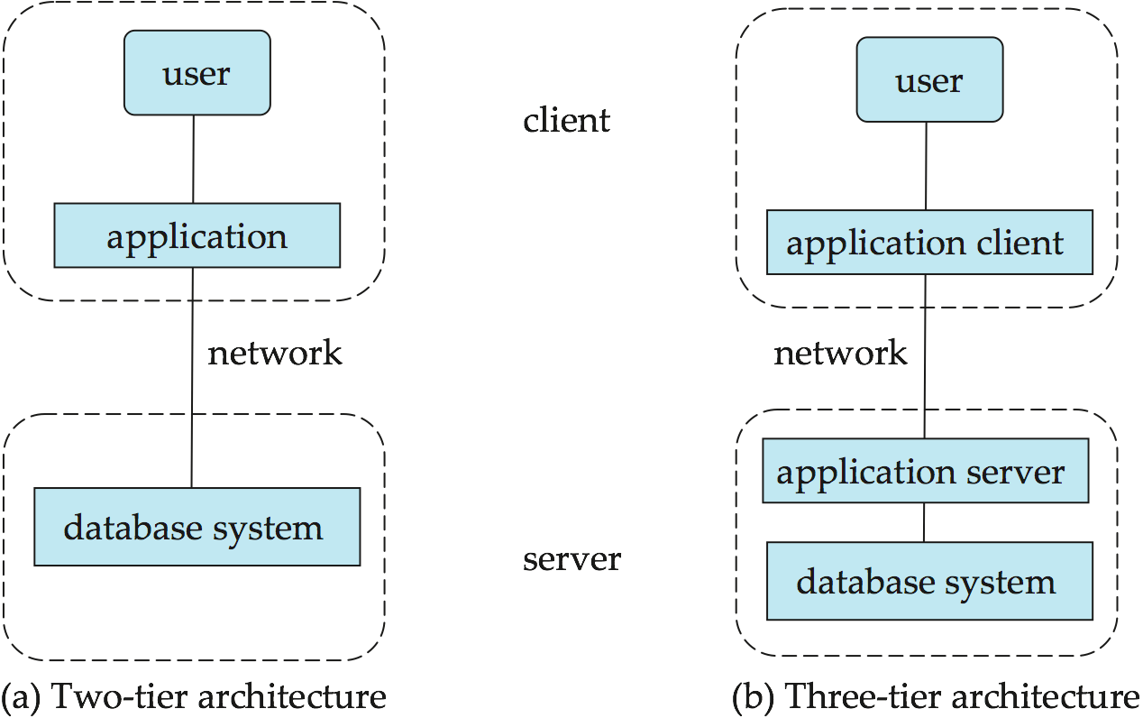
Database architecture
Centralized: run locally on a single computer
Parallel / distributed databases
Most databases today use client-server architecture over network

Slide 22
Database Engine
Major components:
Storage manager
Query processing
Transaction manager
Notes:
A database engine (or storage engine) is the underlying software component that a database management system (DBMS) uses to create, read, update and delete(CRUD) data from a database.
Most database management systems include their own application programming interface (API) that allows the user to interact with their underlying engine
Next slides go into more detail on these three components.

Slide 23
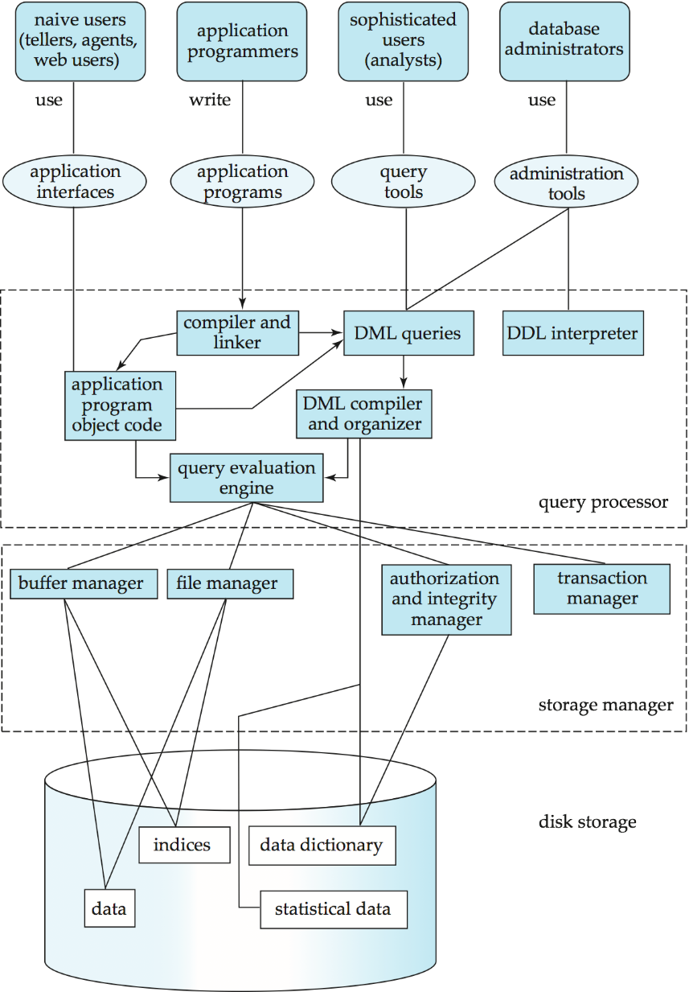
Database System Internals
Notes:
An overview of the complexity of a DBMS. This is a general view. A DBMS can take different forms, such as…

Slide 24
Storage management in a DBMS
Storage manager - a program that provides the interface between the low-level data stored in the database and the application programs and queries submitted to the system.
Responsible for:
Interaction with the file manager
Efficient storing, retrieving and updating of data
Issues:
Storage access
File organization
Indexing and hashing
18
Notes:
What does the DBMS do to process queries made on a database?

Slide 25
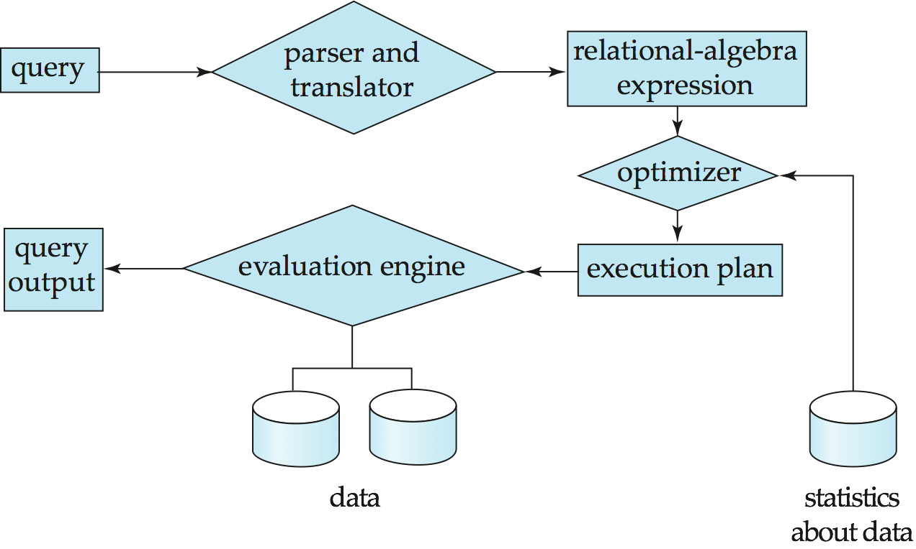
Query processing
Parsing and translation
Optimization
Evaluation
Notes:
Cost difference between equivalent queries can be enormous
Alternative ways of evaluating a given query
Equivalent expressions
Different algorithms for each operation
Cost difference between a good and a bad way of evaluating a query can be enormous
Need to estimate the cost of operations
Depends critically on statistical information about relations which the database must maintain
Need to estimate statistics for intermediate results to compute cost of complex expressions
What else does the DBMS do?

Slide 26
Transaction management and concurrency
System failures (“If anything can go wrong, it will”)
DBMS provides fault-tolerant design using transactions
Concurrency
Interleaving many users may lead to inconsistency and delays

Slide 27
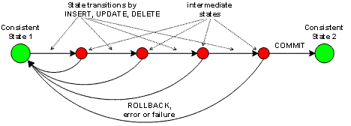
Transaction management and concurrency
A transaction is a collection of operations that performs a single logical function in a database application
Transaction-management component ensures that the database remains in a consistent (correct) state despite system failures (e.g., power failures and operating system crashes) and transaction failures.
Concurrency-control manager controls the interaction among the concurrent transactions, to ensure the consistency of the database.
Notes:
DBMS maintains ACID properties as shown on next slide.

Slide 28
ACID properties
Atomicity: Either all operations of the transaction are properly reflected in the database or none are
Consistency: Execution of a transaction in isolation preserves the consistency of the database
Isolation: Although multiple transactions may execute concurrently, each transaction must be unaware of other concurrently executing transactions
For every pair of transactions Ti and Tj, it appears to Ti that either Tj, finished execution before Ti started, or Tj started execution after Ti finished
Durability: After a transaction completes successfully, the changes it has made to the database persist, even if there are system failures

Slide 29
Database users and administrators
End users use application interfaces (e.g. web/phone user)
Application programmers write functionality (e.g. webmasters)
Analysts use query tools (e.g. statistical business analyst)
Database administrator (DBA)
Designs logical /physical schemas
Handles security and authorization
Data availability, crash recovery
Database tuning as needs evolve
Authorization and abstraction level depend on the user type
Notes:
As you can see, many different types of users interact with the DBMS

Slide 30
Communicating with a DBMS
CMSC 508 – Database Theory

Slide 31
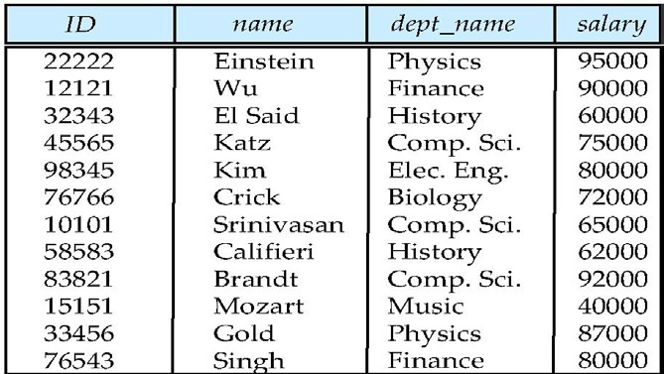
Data Definition Language (DDL)
Specification notation for defining the database schema
Example:
create table instructor (
ID char(5),
name varchar(20),
dept_name varchar(20),
salary numeric(8,2)
)
Columns
(attributes)
Rows (records, tuples)
10
Notes:
Describe what the example means and go back one slide to show the table.

Slide 32
Data Definition Language (DDL)
DDL compiler generates a set of tables stored in a data dictionary
Data dictionary contains metadata
Database schema
Integrity constraints
Primary key
Referential integrity
Authorization rules
10

Slide 33
Data Manipulation Language (DML)
Language for accessing and manipulating the data
Two classes of languages
Procedural
Specifies what data is required and how to get those data
Declarative
Specifies what data is required without specifying how
SQL is the most widely used query language (declarative)
10
Notes:
Language for accessing and manipulating the data organized by the appropriate data model

Slide 34
Data Manipulation Language (DML)
CRUD – four aspects of the data lifecycle
Create / add / insert data
Retrieve / select data
Update data
Delete / remove data

Slide 35
Data Manipulation Language (DML)
Application programs generally access databases through:
Language extensions/frameworks to allow embedded SQL
Application program interface (e.g., ODBC/JDBC) which allow SQL queries to be sent to a database (drivers)
Example: select
from where
name instructor
instructor.ID = ‘22222’
10
Notes:
Before we can define tables with a DDL and manipulate data with DML, we need to know what the best practices are for organizing the data.

Slide 36
Data Models
CMSC 508 – Database Theory

Slide 37
Data Models
A collection of tools for describing
Data
Data relationships
Data semantics
Data constraints
Examples
Relational model
Entity-Relationship data model
Object-oriented data models
Semi-structured data model (XML)
Other older models:
Network model
Hierarchical model
Notes:
We will start with the relational model.

Slide 38
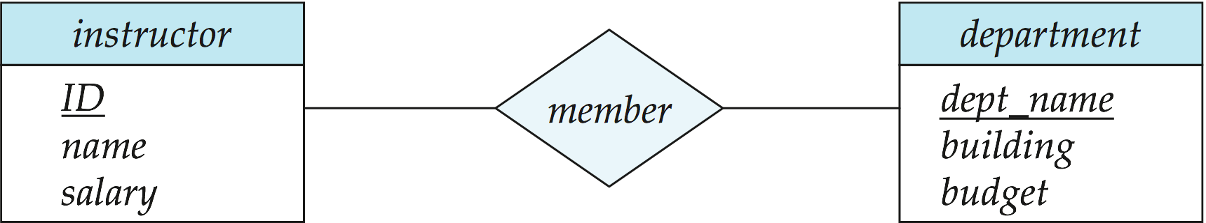
The Entity-Relationship model
Data modelling as a collection of entities and relationships
Represented diagrammatically by an entity-relationship diagram
Unified Modeling Language (UML)
Entity sets are represented by a rectangular box
Relationship sets are represented by a diamond connecting related entity sets
10
Notes:
Entities are translated into tables
We will explore the ER model in more detail over the next few weeks.
Some other ways of modeling data are…

Slide 39
Relational model
Tables == relations
Collection of tables to represent both data and the relationships
Tables have multiple columns with unique names called attributes
Tables contain records (tuples) that correspond to the attributes
Table schema define data types and constraints
Columns
(attributes)
Rows (records, tuples)
Notes:
Two languages are used in the relational model - DDL and DML.

Slide 40
Object-Relational Data Models (ORM)
Objects, classes and inheritance are directly supported in database schemas and in the query language
Extend the relational data model by including object orientation and constructs to deal with added data types
Allow attributes of tuples to have complex types, including non- atomic values such as nested relations
Preserve relational foundations, the declarative access to data, while extending modeling power
Provide upward compatibility with existing relational languages
Pure object databases: ObjectDB for Java
Object-relational frameworks: Hibernate, jOOQ

Slide 41
Semi structured Data Model:
XML - Extensible Markup Language
Originally intended as a document markup language
The ability to specify new tags, and to create nested tag structures made XML a great way to exchange data
XML has become the basis for new generation data interchange
A wide variety of tools is available for parsing, browsing and querying XML documents/data
Notes:
Example on next slide

Slide 42
<?xml version="1.0"?>
<catalog>
<book id="bk101">
<author> Gambardella, Matthew</author>
<title> XML Developer's Guide</title>
<genre> Computer</genre>
<price> 44.95</price>
<publish_date> 2000-10-01</publish_date>
<description>
An in-depth look creating applications with XML.
</description>
</book>
</catalog>
Semi structured Data Model:
XML - Extensible Markup Language
Notes:
Next, how does the DBMS interact with OS storage?

Slide 43
Summary
DBMS consists of a collection of interrelated data and programs
DBMS provide an environment that is both convenient and efficient to use in retrieving and storing information
A major purpose of a database system is to provide users with an abstract view of the data
The relational data model is the most widely deployed model for storing data in databases
DDL and DML allow users to specify, access and manipulate data
Transaction management ensures that the database remains in a consistent (correct) state despite system failures
There are four different types of database-system users, differentiated by the way to interact with the system

Slide 44
Review Terms
Database management system (DBMS)
Data inconsistency
Consistency constraints
Data abstraction
Instance
Schema - Physical schema / Logical schema
Physical data independence
Data models
Entity-relationship model
Relational data model
Object-based data model
Semi-structured data model Database languages

